Slide 1
Basics of Machine Learning with Python
A 2 day hands on workshop by Evam Kaushik

Slide 2
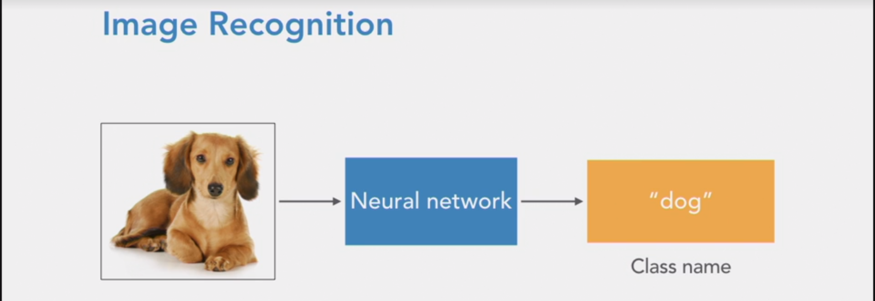
Classification
This is the simplest use of machine learning and excellent to understand the underlying concepts and structures. We will take for example Image recognition.
Image recognition is the ability for computers to look at a photograph and understand what's in the photograph. Here we're passing in a picture to the neural network, and the neural network is generating a label, dog, because that's the main object that appears in the picture.

Slide 3
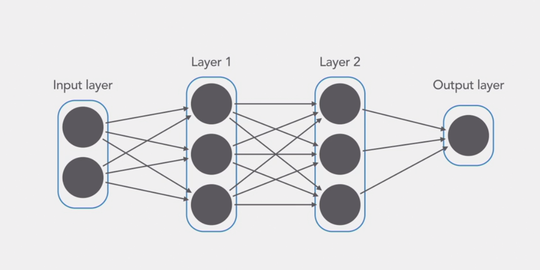
A neural network is made up of separate nodes called neurons. These neurons are arranged into a series of groups called layers. Nodes in each layer are connected to the nodes in the following layer. Data flows from the input to the output along these connections. Each individual node is trained to perform a simple mathematical calculation and then feed its result to all the nodes it's connected to. The neural network takes in a set of input values in the input layer. Then those values pass through all the following layers. Each node tweaks the value it receives slightly and passes its result onto the next node.

Slide 4
Let’s code it up!
Steps we’ll be following :
Import necessary libraries
Import dataset
Explore Dataset
Preprocess Data
Build Model
Setup the structure
Compile Model
Train Model
Feed model
Evaluate accuracy
Use trained Model

Slide 5
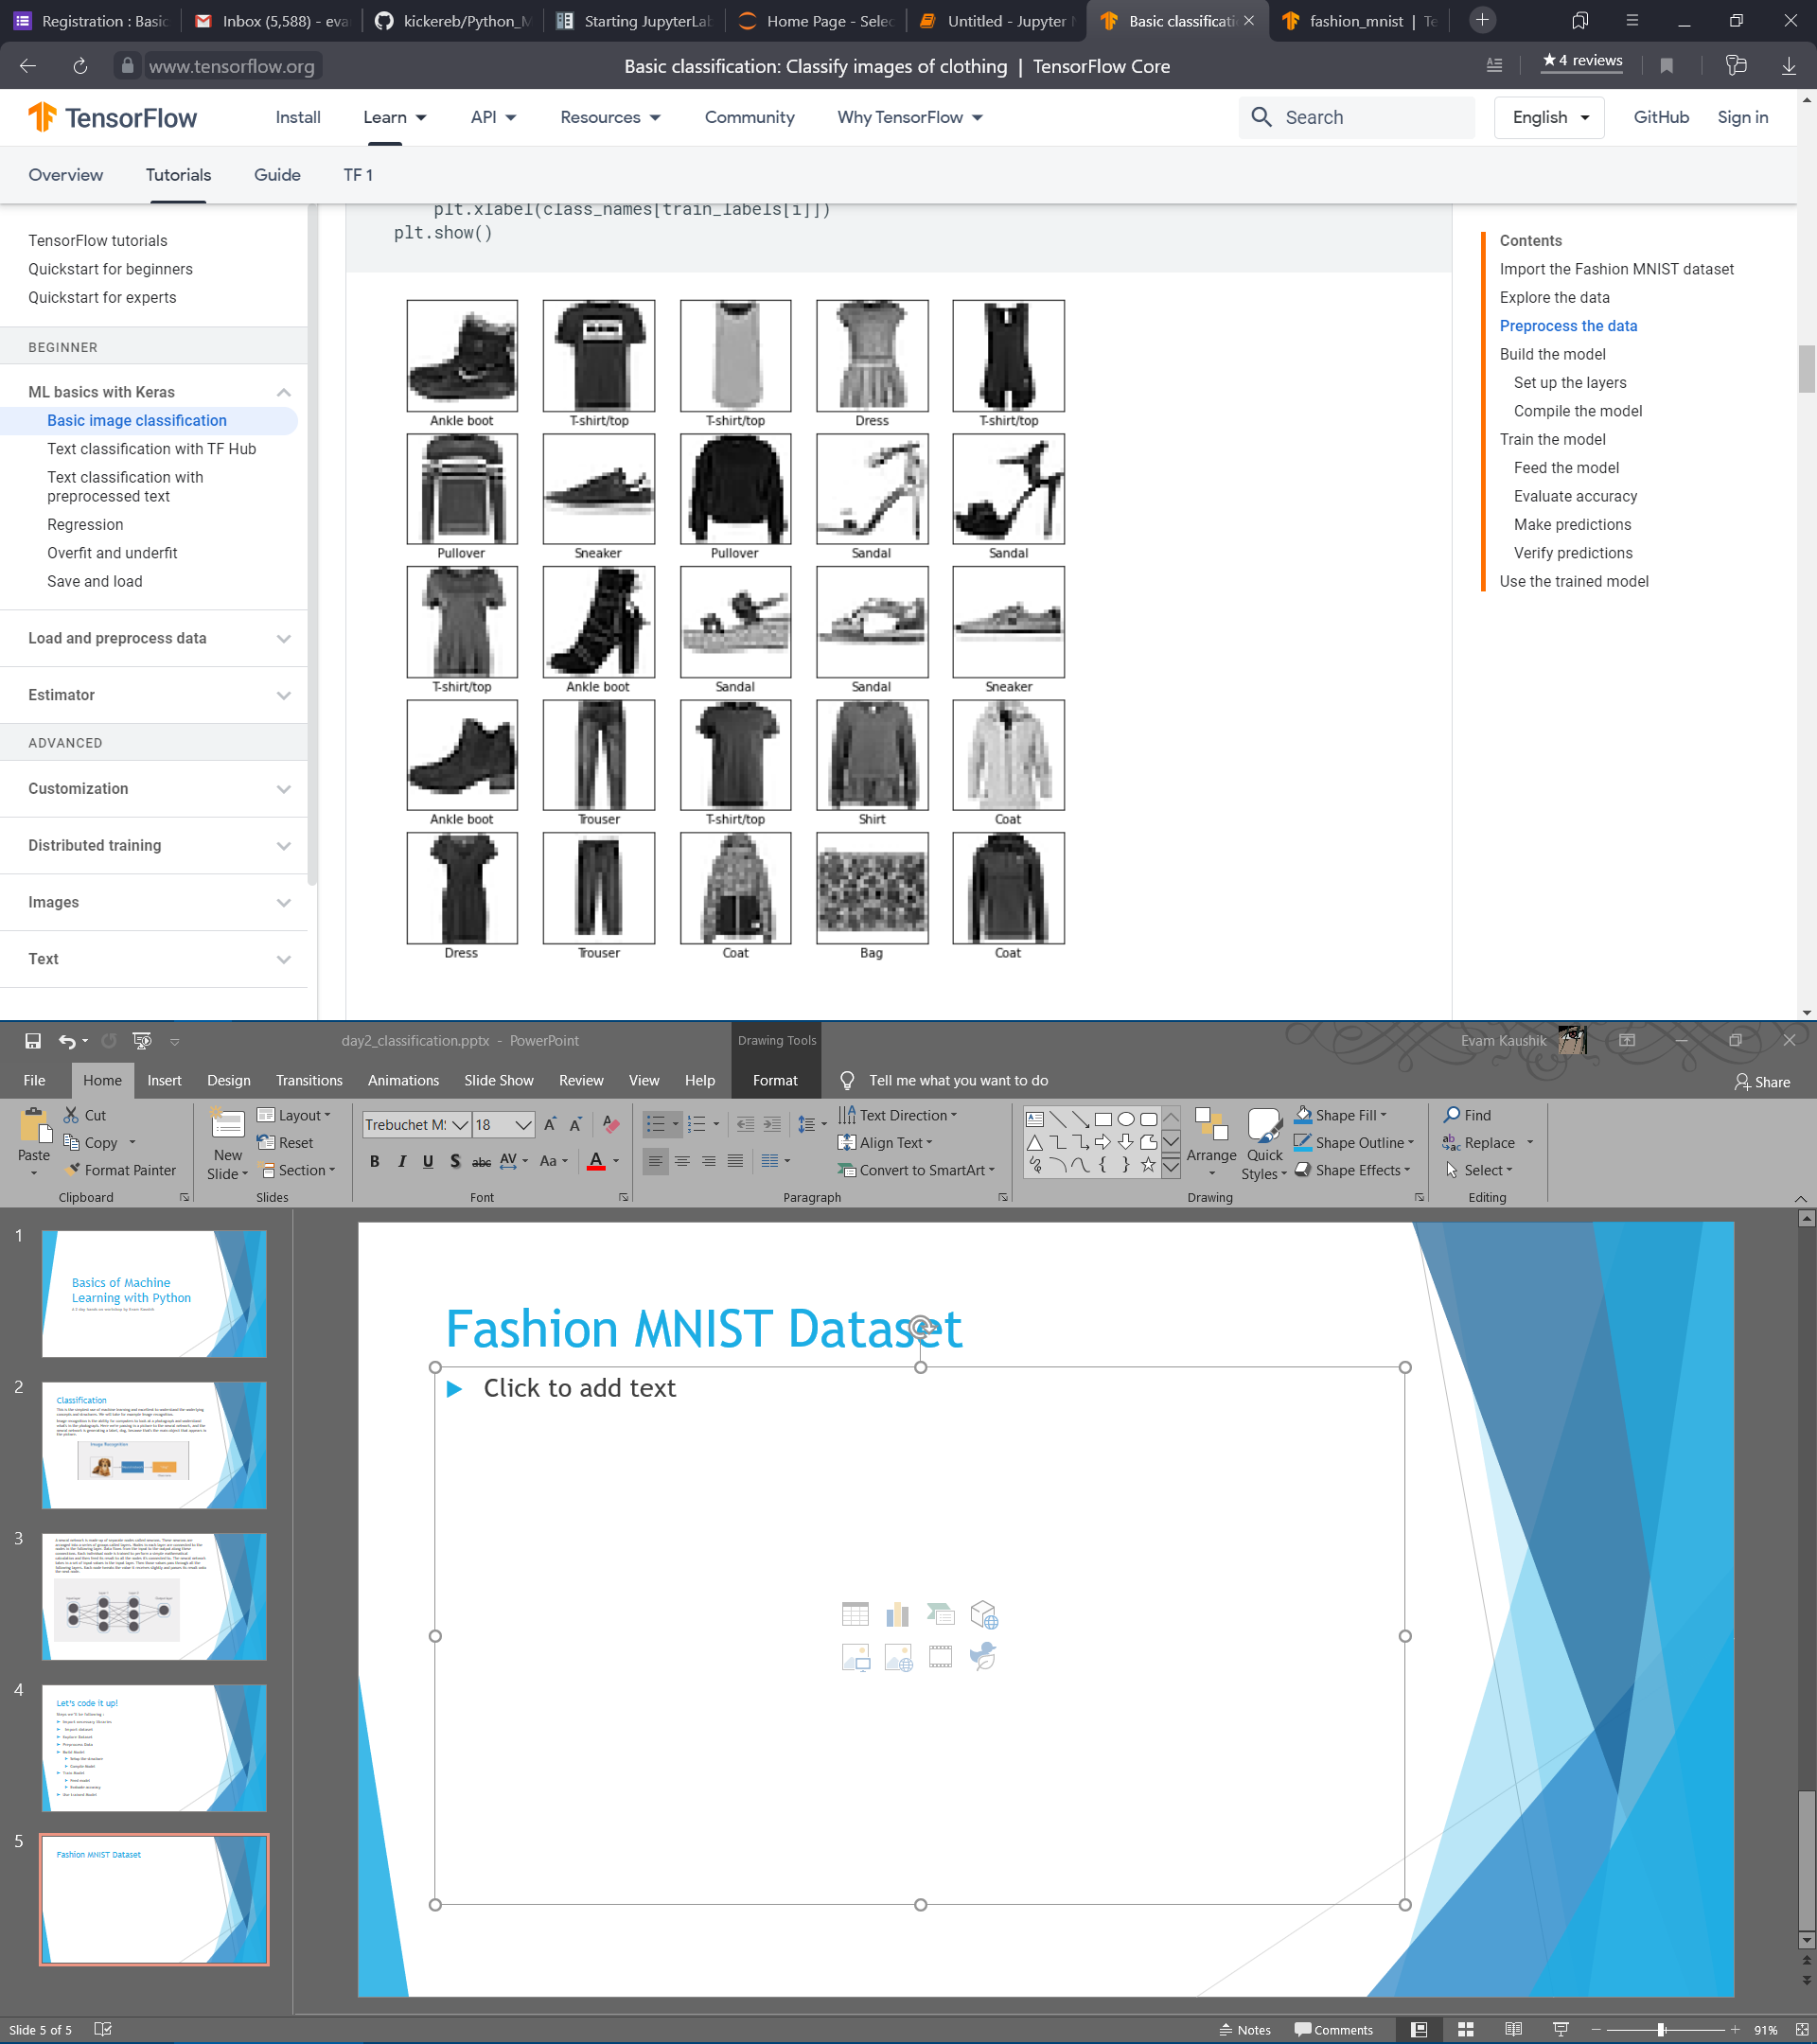
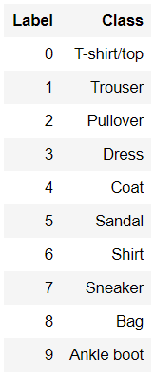
Fashion MNIST Dataset
The Fashion MNIST dataset is an organized and labeled set of items of clothing of the following classes
'T-shirt/top', 'Trouser', 'Pullover', 'Dress', 'Coat’, 'Sandal', 'Shirt', 'Sneaker', 'Bag', 'Ankle boot’
Followed by their respective labels
Each image is 28pixel by 28pixel in size and only one color channel (gray scale).

Slide 6
Our Job
We have to design a neural network that can predict what class the given item belongs to.
Our Model
Output : 0
(Tshirt)

